Slide 1
CareEvolve Molecular Pathology Clinical Portal
Submitting Oncology Orders for Testing

Slide 2
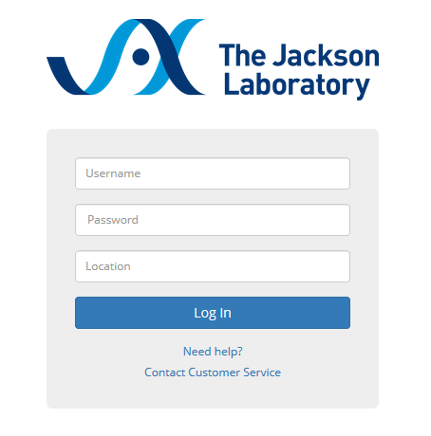
Logging into the Portal
URL: https://jax.careevolve.com/
Username*
Password*
Location*
* You will receive your username, temporary password and location code. On first log in you will be required to change your password, click submit and accept. The location code is a set abbreviation for your institution.
Notes:
Key points:
Submit via Service Portal (want to minimize non-standard requests and emails)
“Request on behalf”; requested for is always the person that this request is for, not the submitter.
Standard approvals to be applied (manager, service owner) but not always required
Fulfillment by tasks to a fulfillment group who then chooses a Technician to execute the task
Standard notifications to keep user aware of the progress
Measurement system to help us baseline

Slide 3
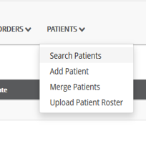
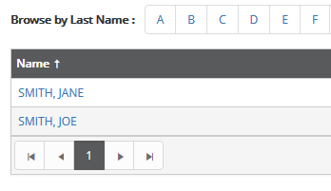
Patient Search/Add
To search for a patient that has already been entered, select Search Patients in the PATIENTS drop-down menu at the top
Click on the first initial of the last name and Select the patient from the returned list
Click Create New Order to enter a new order for the patient
Notes:
Key points:
Submit via Service Portal (want to minimize non-standard requests and emails)
“Request on behalf”; requested for is always the person that this request is for, not the submitter.
Standard approvals to be applied (manager, service owner) but not always required
Fulfillment by tasks to a fulfillment group who then chooses a Technician to execute the task
Standard notifications to keep user aware of the progress
Measurement system to help us baseline

Slide 4
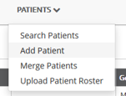
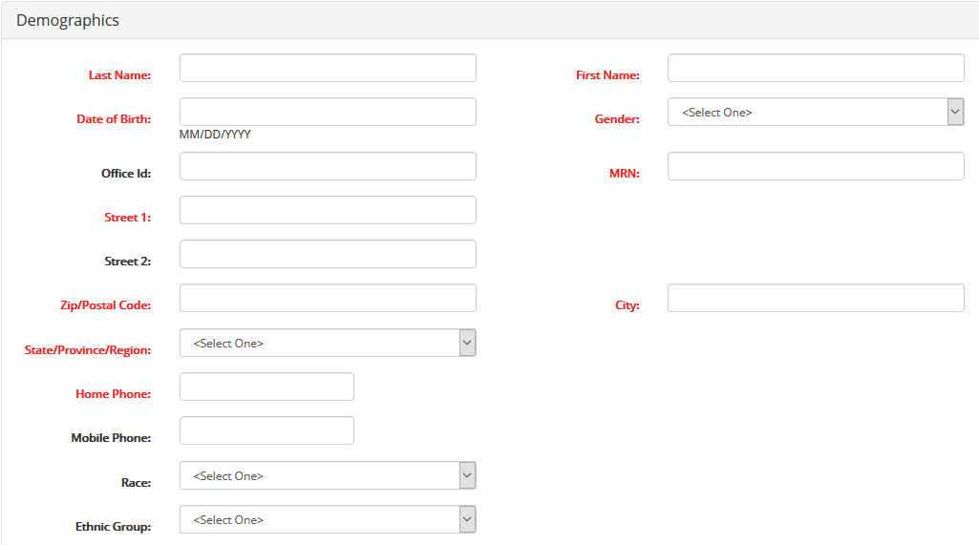
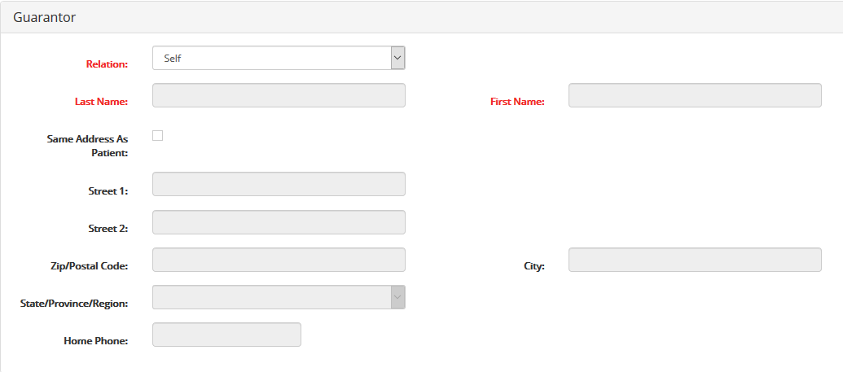
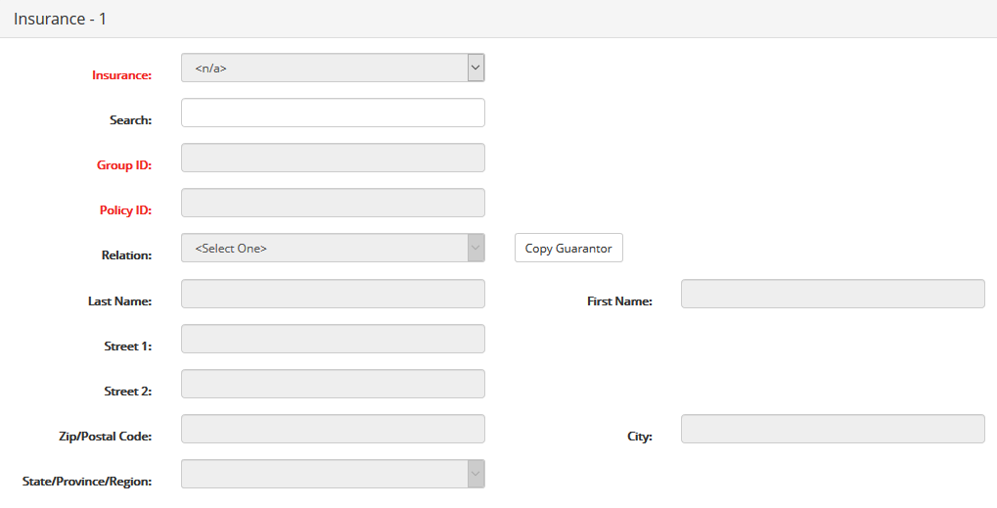
Patient Search/Add- cont’d
If a patient does not exist, select Add Patient in the PATIENTS drop-down menu at the top
Enter Patient Demographics, Guarantor, and Insurance information - required fields in red
*Additional details for Insurance entry on next slide
Select Save, Save & Place Order OR Cancel
Notes:
Key points:
Submit via Service Portal (want to minimize non-standard requests and emails)
“Request on behalf”; requested for is always the person that this request is for, not the submitter.
Standard approvals to be applied (manager, service owner) but not always required
Fulfillment by tasks to a fulfillment group who then chooses a Technician to execute the task
Standard notifications to keep user aware of the progress
Measurement system to help us baseline

Slide 5
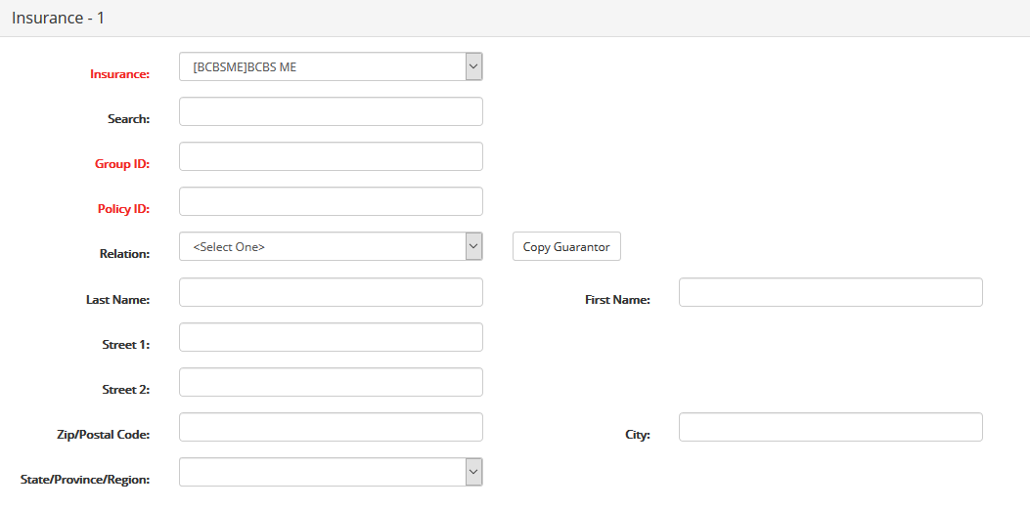
Insurance Entry
In the Search field, type the first letter of the patient’s insurance and select the insurance company from the list that appears.
If it does not appear, select Other. You can then add the name of the insurance company.
Enter the Group ID and Policy ID
If the Guarantor is the primary subscriber click Copy Guarantor. If it is not, select the Relation from the drop down and enter the Last Name and First name.
* If the patient has a secondary insurance, there is an Insurance – 2 section to add this information
Notes:
Key points:
Submit via Service Portal (want to minimize non-standard requests and emails)
“Request on behalf”; requested for is always the person that this request is for, not the submitter.
Standard approvals to be applied (manager, service owner) but not always required
Fulfillment by tasks to a fulfillment group who then chooses a Technician to execute the task
Standard notifications to keep user aware of the progress
Measurement system to help us baseline

Slide 6
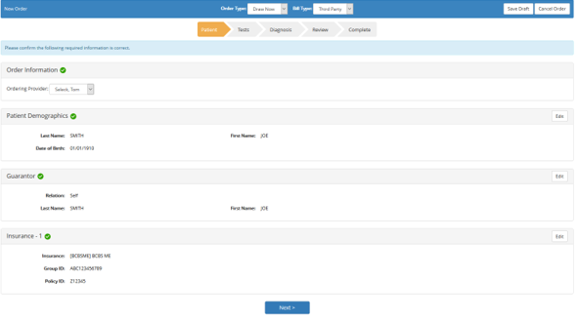
Order Entry
Choose Bill Type from the drop down: Client Bill, Patient, or Third Party
Choose Draw Later from the drop down
Choose the Ordering Provider from
the drop down
*If the provider is not listed send the name and NPI to CGL_CS@jax.org and we will add and advise when complete
Confirm the data entered and click Next
Choose the Test Type:
JAX SOMASEQ™
JAX SOMASEQ™ Complete (includes PD-L1)
JAX OncoMethyl™ Array
JAX MGMT Promoter Methylation
*Start typing the letter of the test and the options will appear. If the patient had previous testing you will see Recent Tests and can select that if it is the same that you want to order now
After selecting the Test Type, click Next
Notes:
Key points:
Submit via Service Portal (want to minimize non-standard requests and emails)
“Request on behalf”; requested for is always the person that this request is for, not the submitter.
Standard approvals to be applied (manager, service owner) but not always required
Fulfillment by tasks to a fulfillment group who then chooses a Technician to execute the task
Standard notifications to keep user aware of the progress
Measurement system to help us baseline

Slide 7
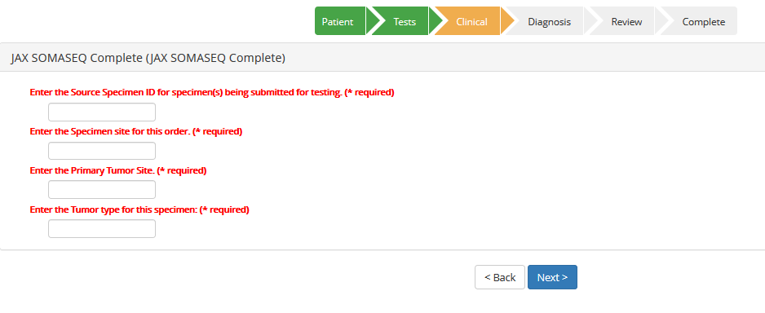
Order Entry- cont’d
Depending on the test ordered, specimen information may be requested. Complete the Specimen Details as required:
Specimen ID (path accession)
Specimen Site (this specimen)
Primary Tumor Site (origin)
Tumor Type/Diagnosis
After entering the specimen details, click Next
Select the ICD-10 Diagnosis
You can start to type the diagnosis or enter the ICD-10 code and select from the list that appears
After entering the diagnosis, click Next
Notes:
Key points:
Submit via Service Portal (want to minimize non-standard requests and emails)
“Request on behalf”; requested for is always the person that this request is for, not the submitter.
Standard approvals to be applied (manager, service owner) but not always required
Fulfillment by tasks to a fulfillment group who then chooses a Technician to execute the task
Standard notifications to keep user aware of the progress
Measurement system to help us baseline

Slide 8
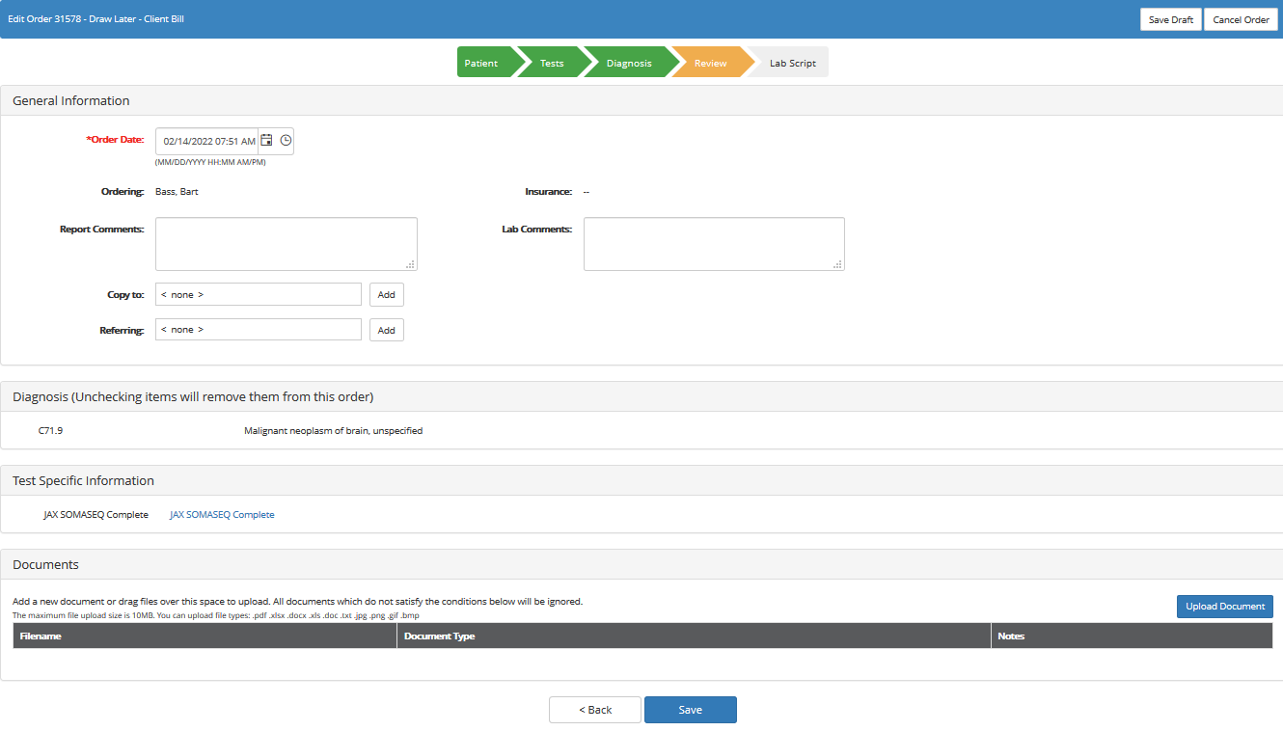
Order Entry- cont’d
Save Draft or Cancel Order options
Upload Clinical Documents
Click Save
*If you need to edit any details click Back
Please upload the clinical notes and pathology report and click Save. We will check daily for order entries and reach out to the pathology group to have the specimen forwarded to us. If you would like to follow up and confirm order receipt or sample progress, please send an email to cgl_cs@jax.org
Notes:
Key points:
Submit via Service Portal (want to minimize non-standard requests and emails)
“Request on behalf”; requested for is always the person that this request is for, not the submitter.
Standard approvals to be applied (manager, service owner) but not always required
Fulfillment by tasks to a fulfillment group who then chooses a Technician to execute the task
Standard notifications to keep user aware of the progress
Measurement system to help us baseline

Slide 9
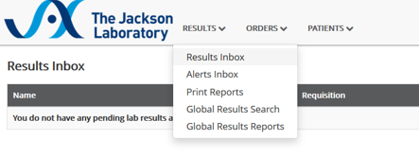
Report Retrieval
There are 2 ways to retrieve reports:
Go to Results Inbox in the RESULTS drop down at the top
It will return any cases that have just reported, there will be a printer icon to click to download the results.
Go to Search Patients in the PATIENTS drop down at the top
Click on the first initial of the last name and Select the patient from the returned list
All orders for this patient will list and there will be a report date and a printer icon. Click the printer icon to download the report.
*A system-generated notification will be sent by email when a report is available
Notes:
Key points:
Submit via Service Portal (want to minimize non-standard requests and emails)
“Request on behalf”; requested for is always the person that this request is for, not the submitter.
Standard approvals to be applied (manager, service owner) but not always required
Fulfillment by tasks to a fulfillment group who then chooses a Technician to execute the task
Standard notifications to keep user aware of the progress
Measurement system to help us baseline

Slide 10
For questions or issues, please contact our Clinical Customer Support Team by email CGL_CS@jax.org or phone 860.837.2320

